Slide 1

Everyone’s Invited
A Case Study on Bridging the Usability Gap
Becca Krouse
R/Pharma 2023

Slide 2
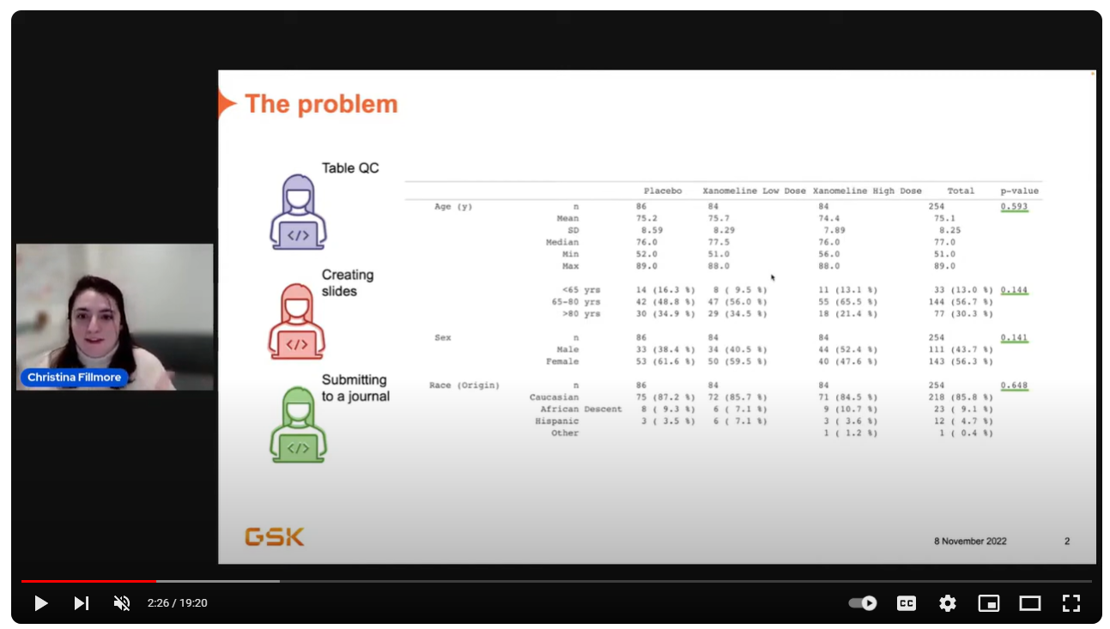
“Why do I spend all my life formatting tables?”
R/Pharma Youtube Channel

Slide 3

don’t
“Why do I spend all my life formatting tables?”

Slide 4
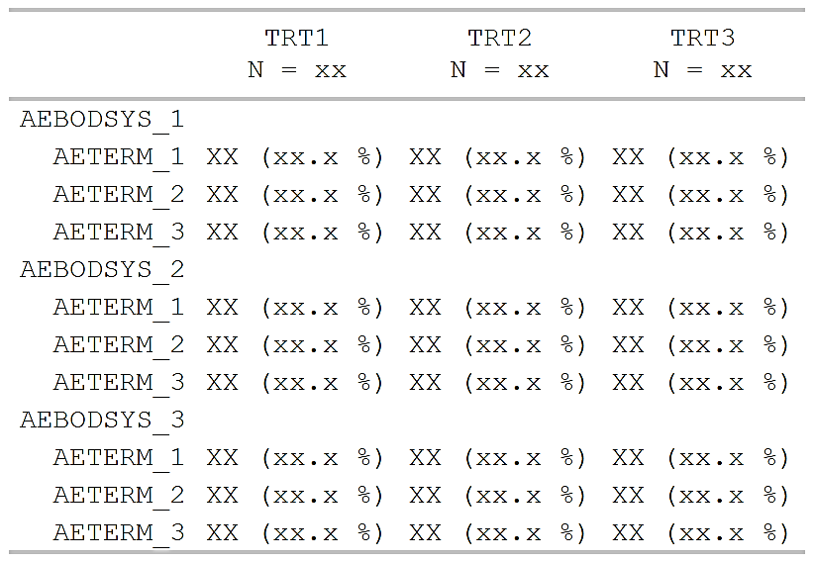
don’t
“Why do I spend all my life formatting tables?”

Slide 5
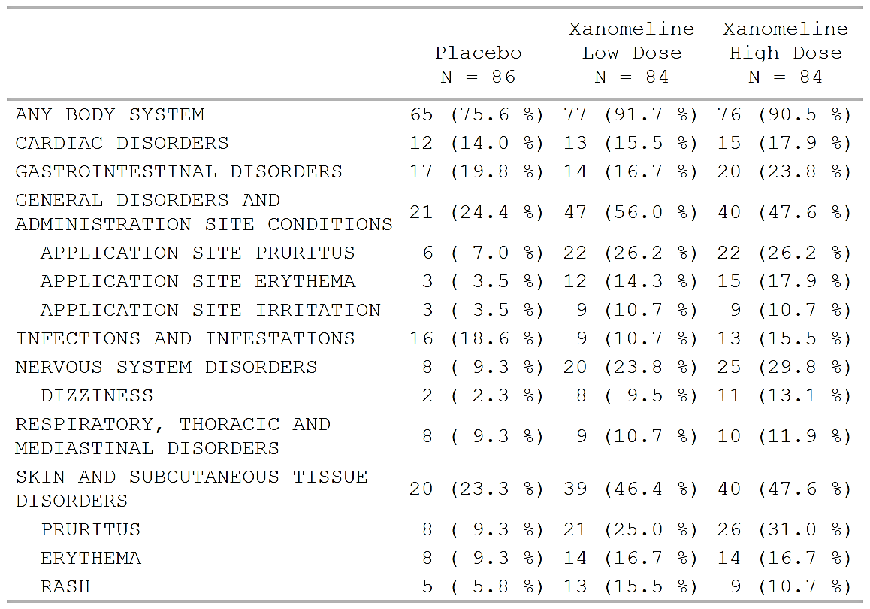
don’t
“Why do I spend all my life formatting tables?”
+ ARD
(Analysis
Results
Data)

Slide 6
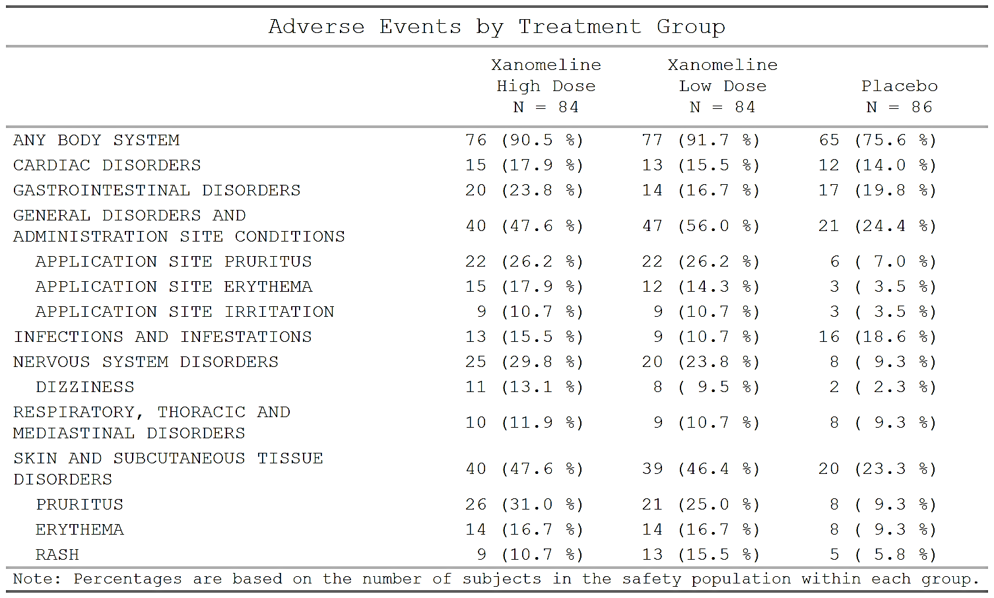
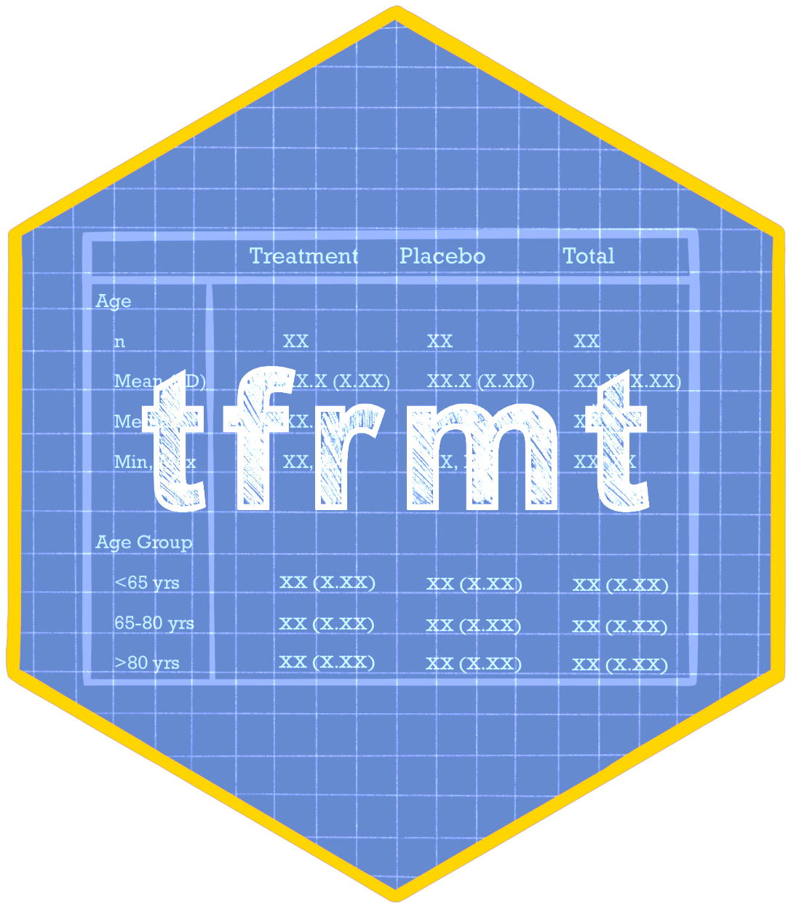
don’t
“Why do I spend all my life formatting tables?”
+ ARD
(Analysis
Results
Data)

Slide 7

R programmers

Slide 8

Everyone else

Slide 9


+
=

Slide 10
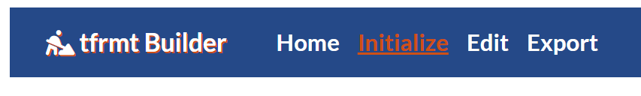
Define starting point

Slide 11
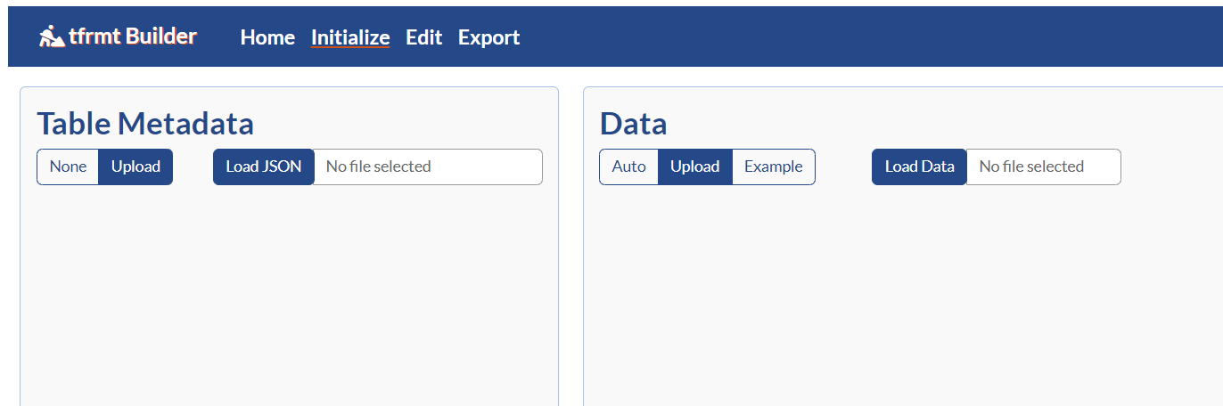

tfrmt_ae.json
ard_ae.csv
{
"group": ["AEBODSYS"],
"label": ["AETERM"],
"param": ["param"],
"value": ["value"],
"column": ["TRT"],
"row_grp_plan": {
"struct_list": [],
"label_loc": {
"location": ["indented"],
"indent": [" "]
}
},
"body_plan": [
{
"group_val": [".default"],
"label_val": [".default"],
"param_val": ["n", "pct"],
"frmt_combine": {
"expression": ["{n} {pct}"],
"frmt_ls": {
"n": {
"frmt": {
AEBODSYS | AETERM | TRT | param | value | ord1 | ord2
ANY BODY SYSTEM | ANY BODY SYSTEM | Placebo | n | 65.000000 | 0 | 0
ANY BODY SYSTEM | ANY BODY SYSTEM | Placebo | pct | 75.581395 | 0 | 0
ANY BODY SYSTEM | ANY BODY SYSTEM | Xanomeline Low Dose | n | 77.000000 | 0 | 0
ANY BODY SYSTEM | ANY BODY SYSTEM | Xanomeline Low Dose | pct | 91.666667 | 0 | 0
ANY BODY SYSTEM | ANY BODY SYSTEM | Xanomeline High Dose | n | 76.000000 | 0 | 0
ANY BODY SYSTEM | ANY BODY SYSTEM | Xanomeline High Dose | pct | 90.476190 | 0 | 0
CARDIAC DISORDERS | CARDIAC DISORDERS | Placebo | n | 12.000000 | 1 | 0
CARDIAC DISORDERS | CARDIAC DISORDERS | Placebo | pct | 13.953488 | 1 | 0

Slide 12
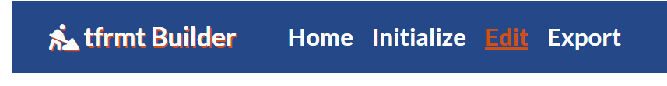

Build or modify table
Define starting point

Slide 13
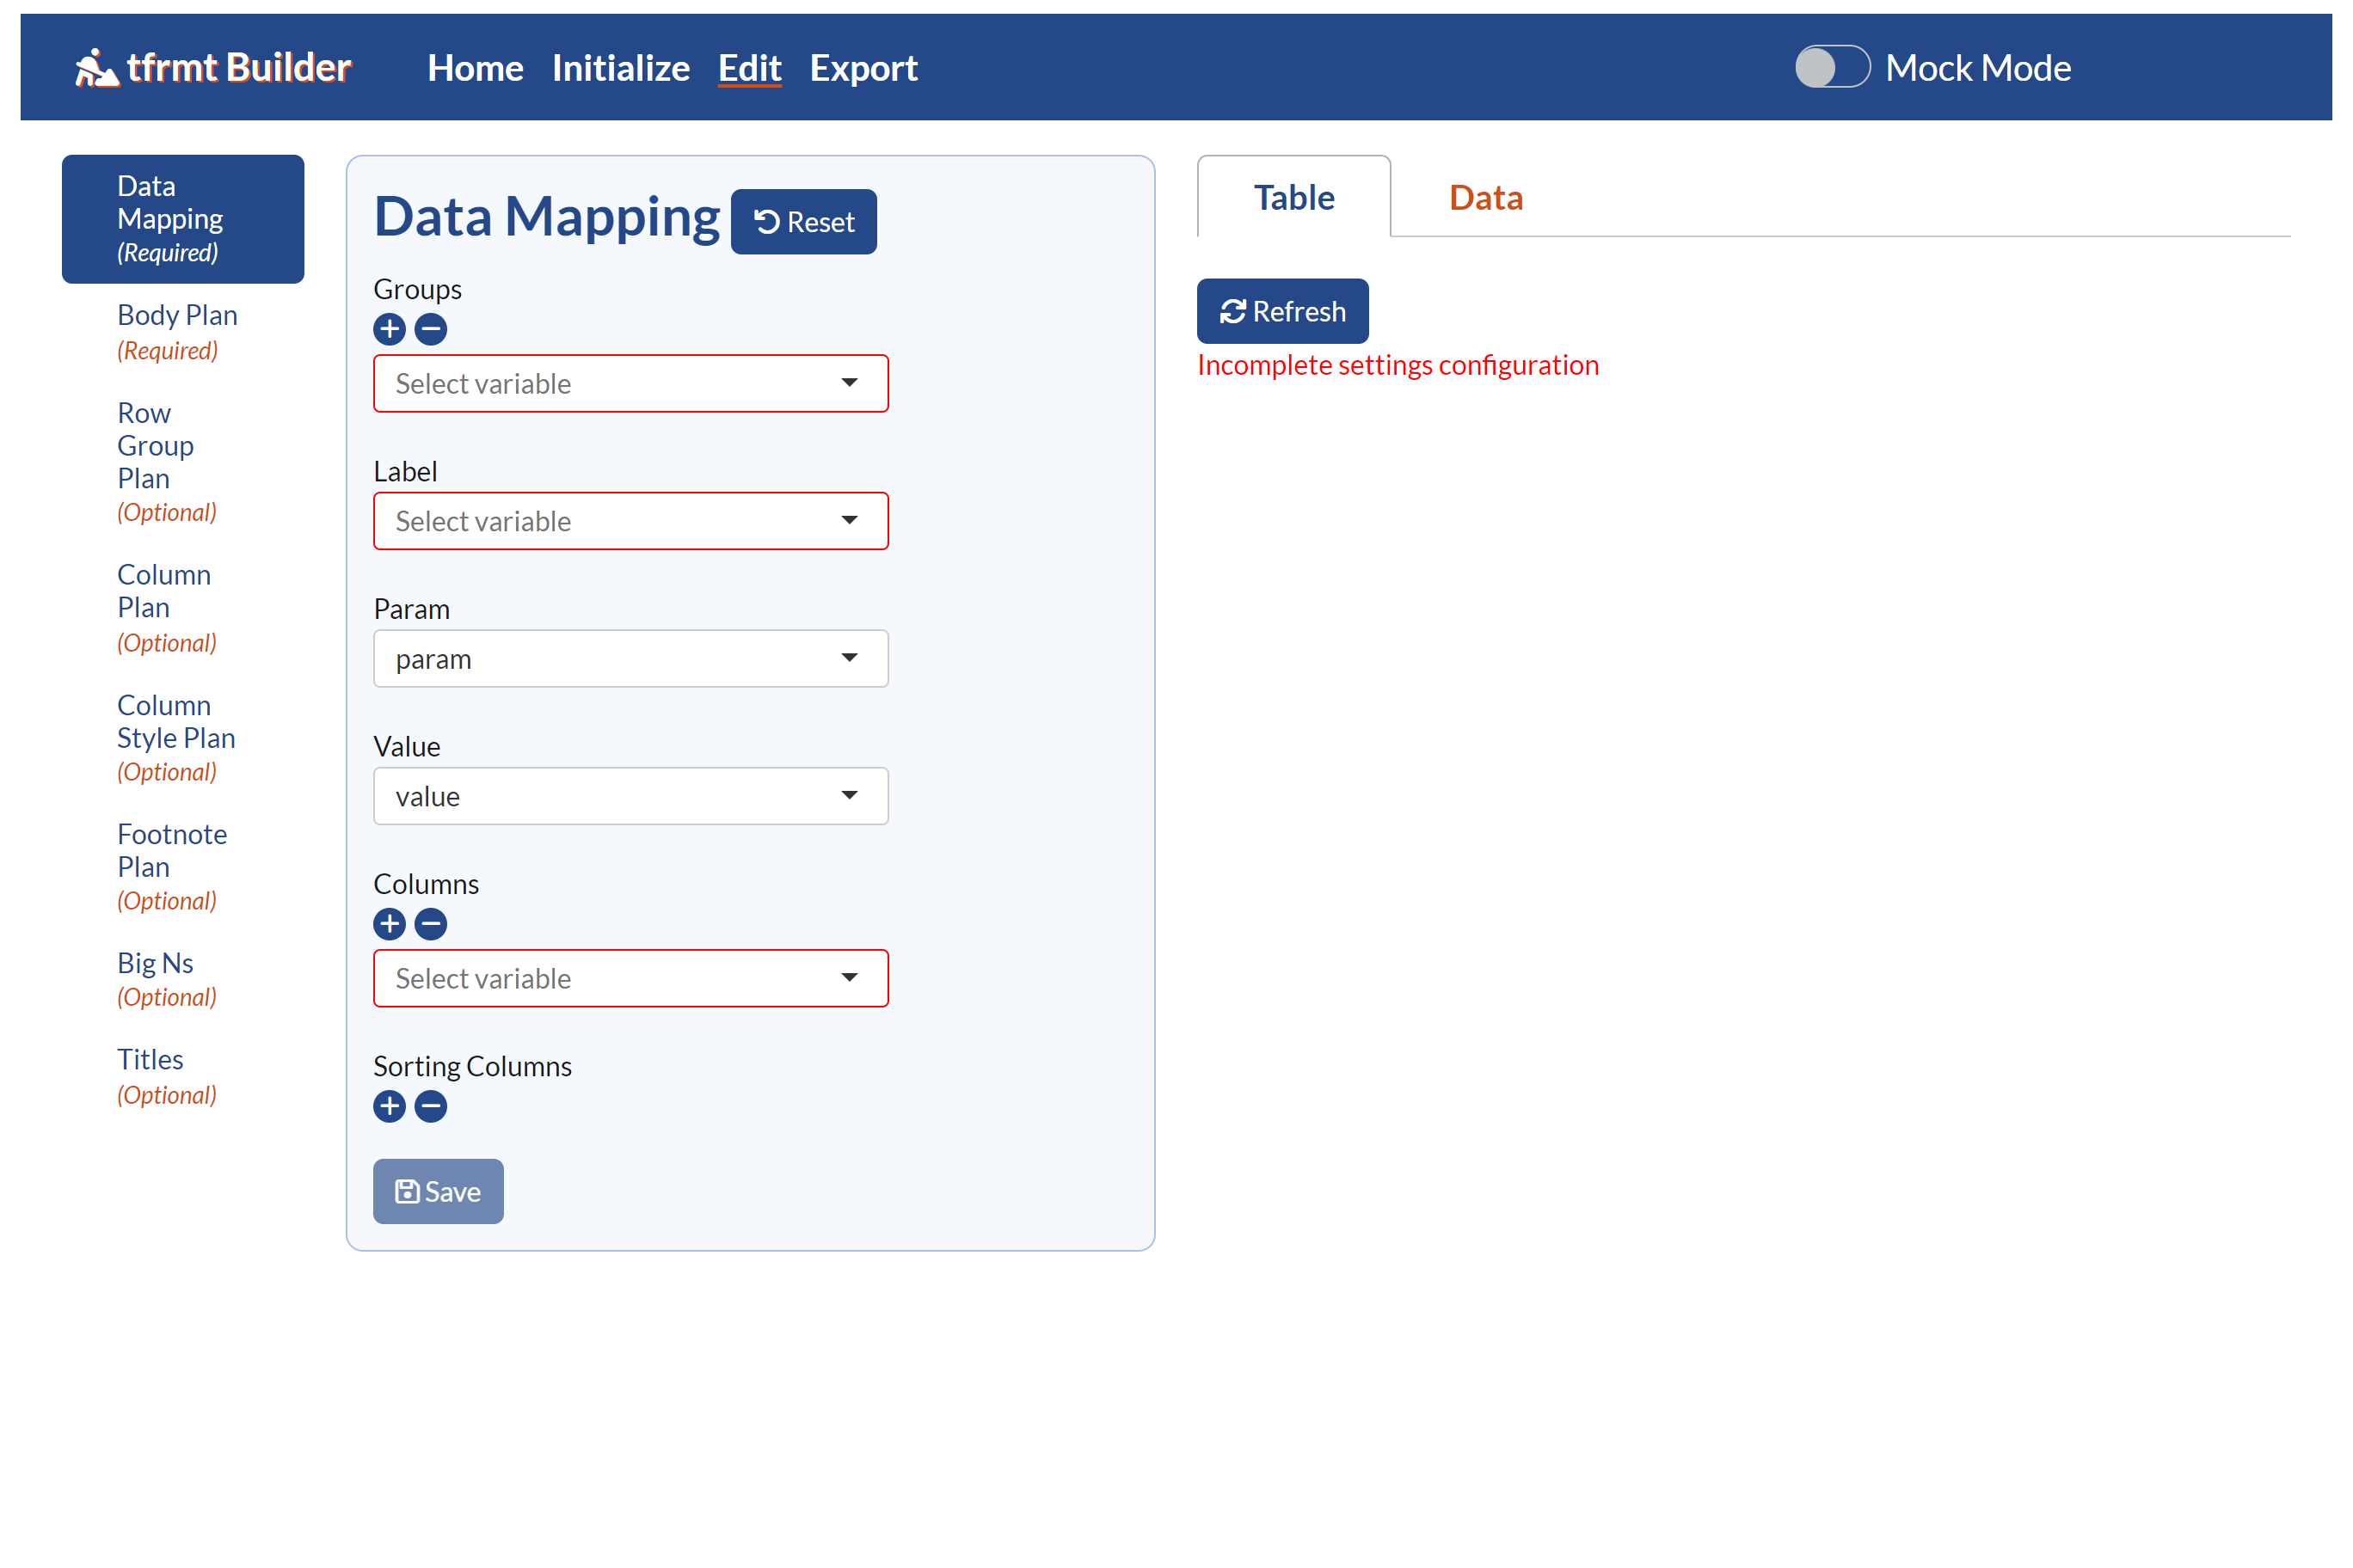

Slide 14
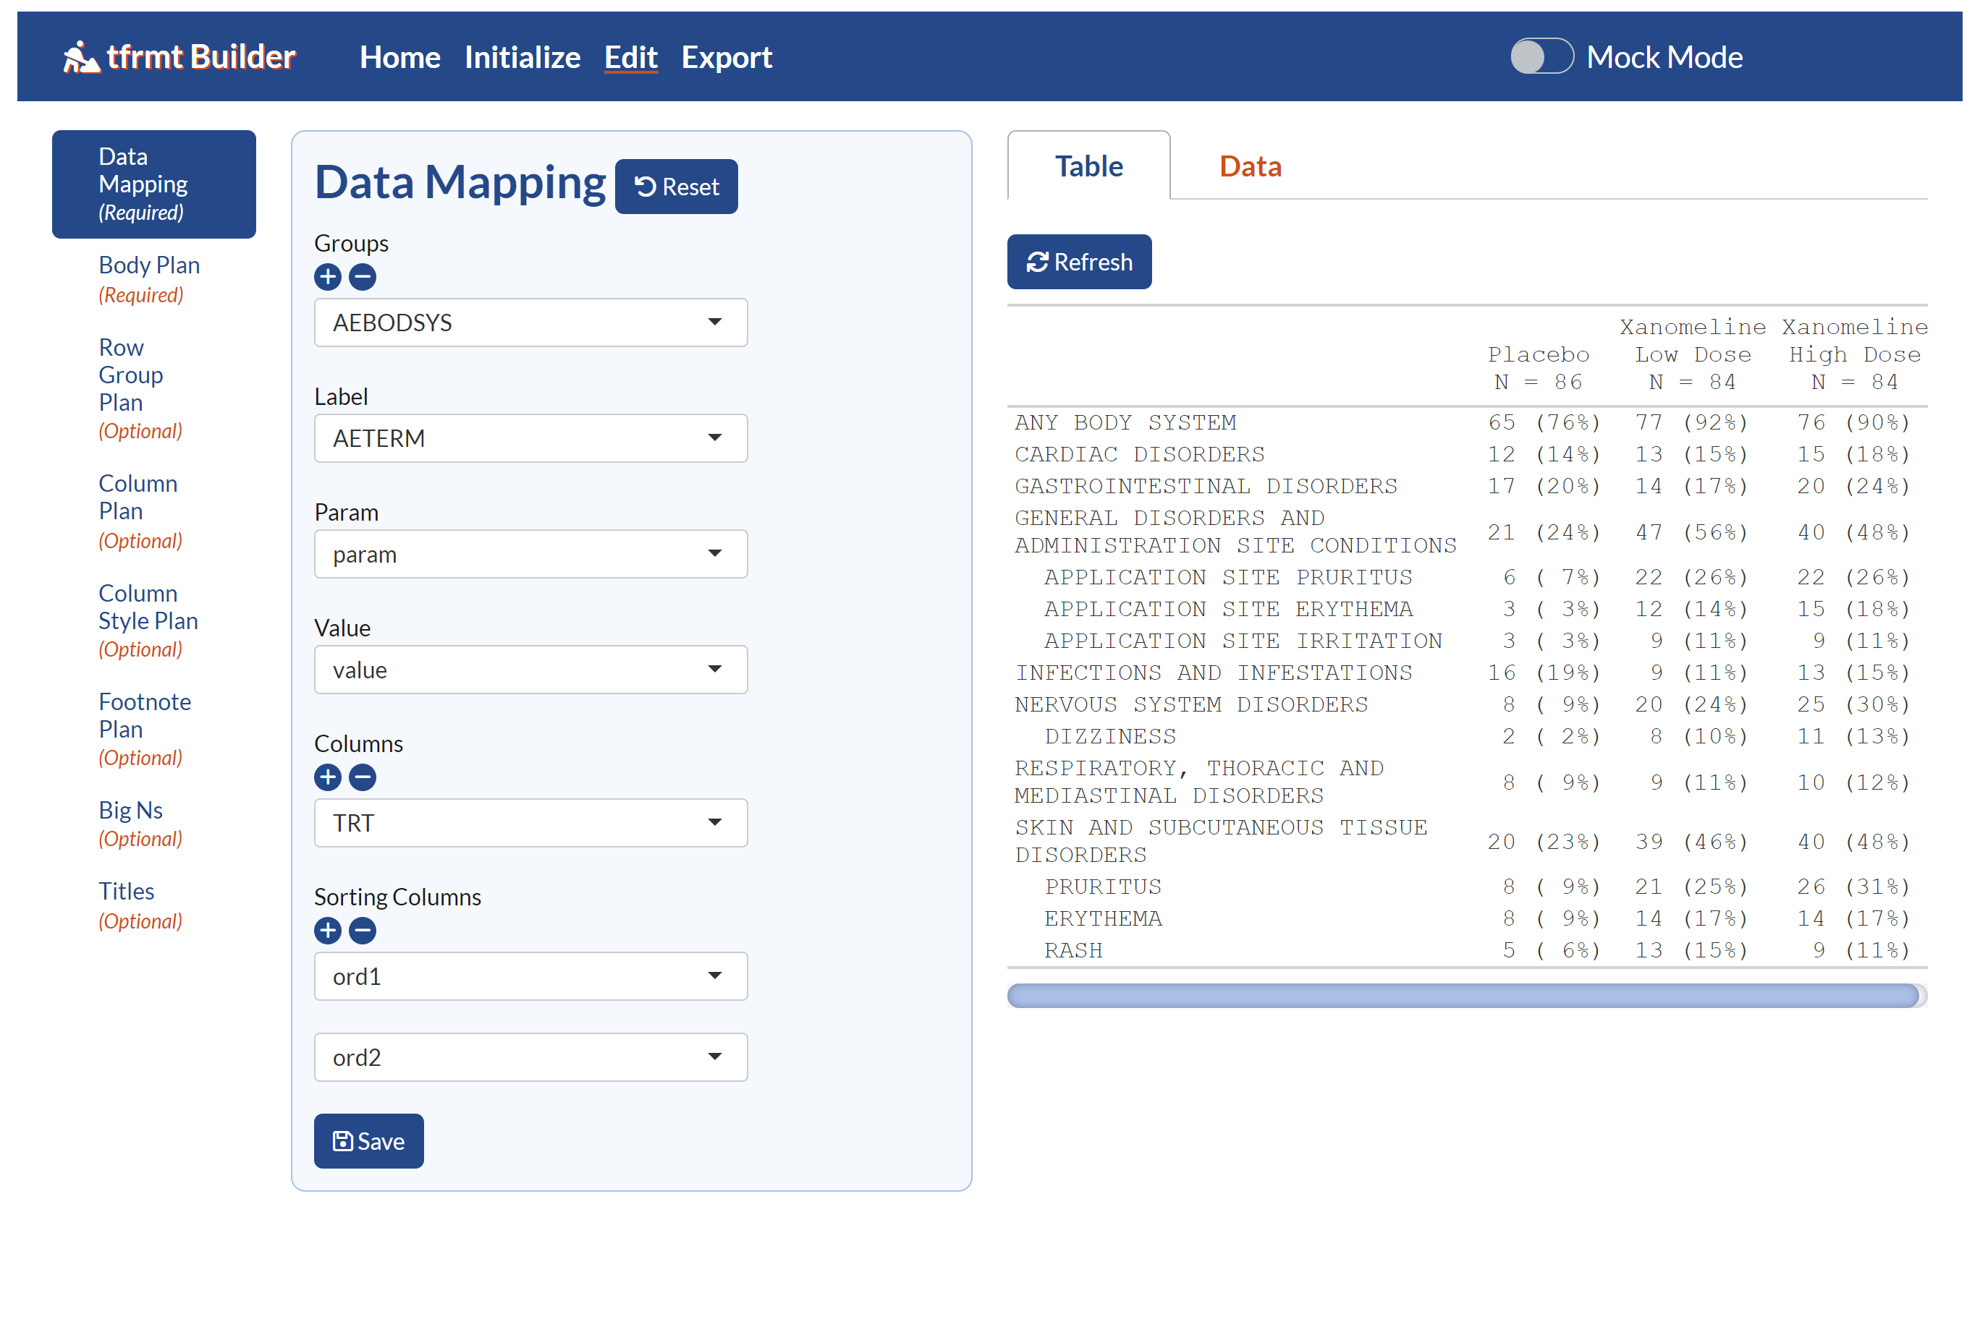

Slide 15
Modify
View

Slide 16
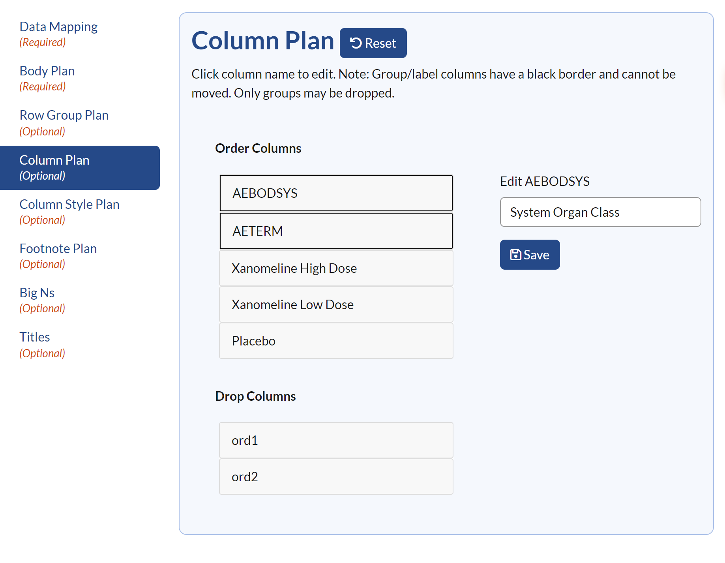


Slide 17
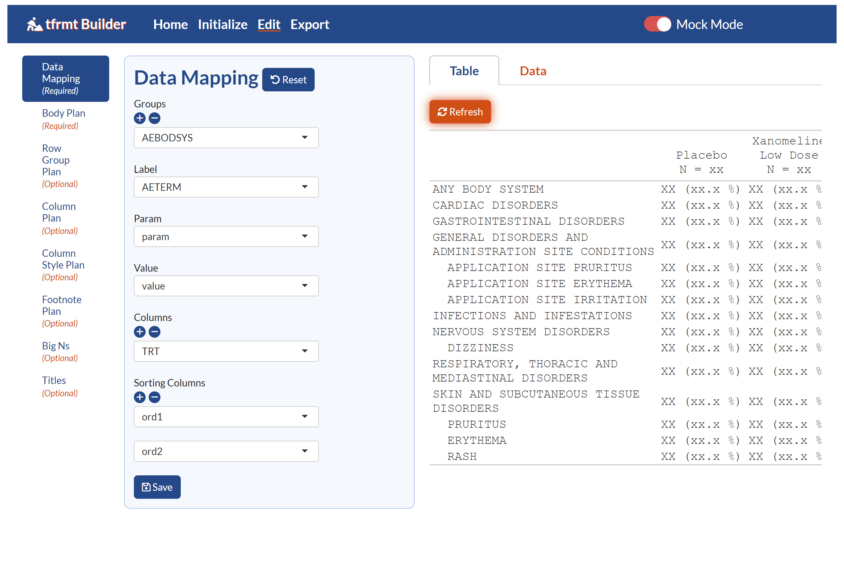
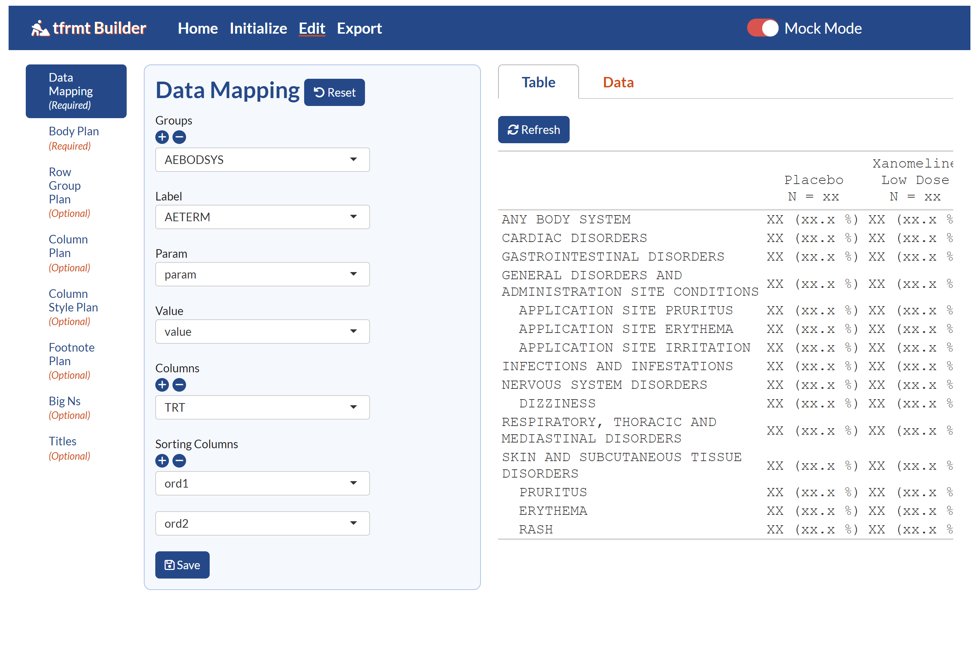
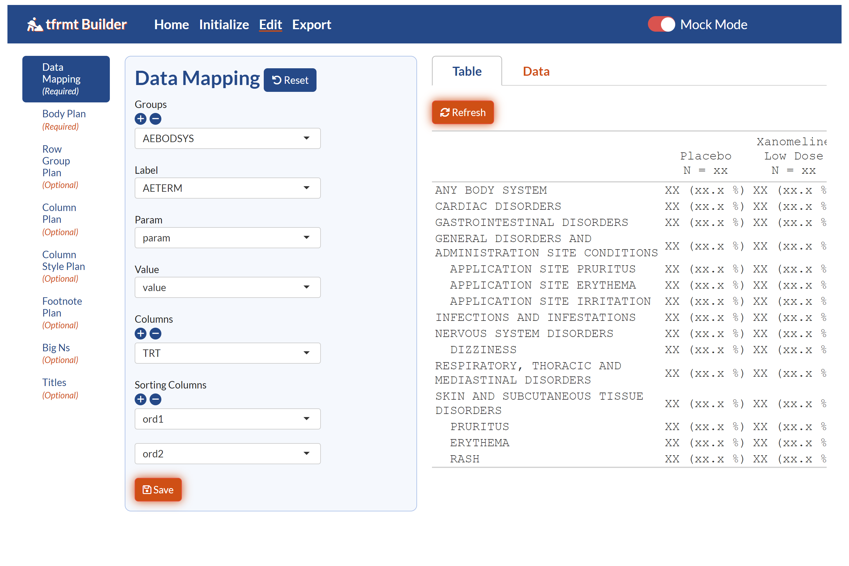

Slide 18
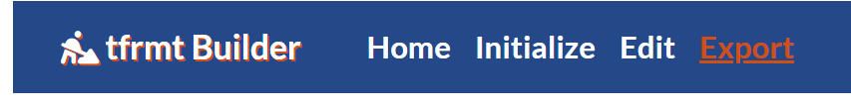
Build or modify table
Define starting point
Save
Result

Slide 19
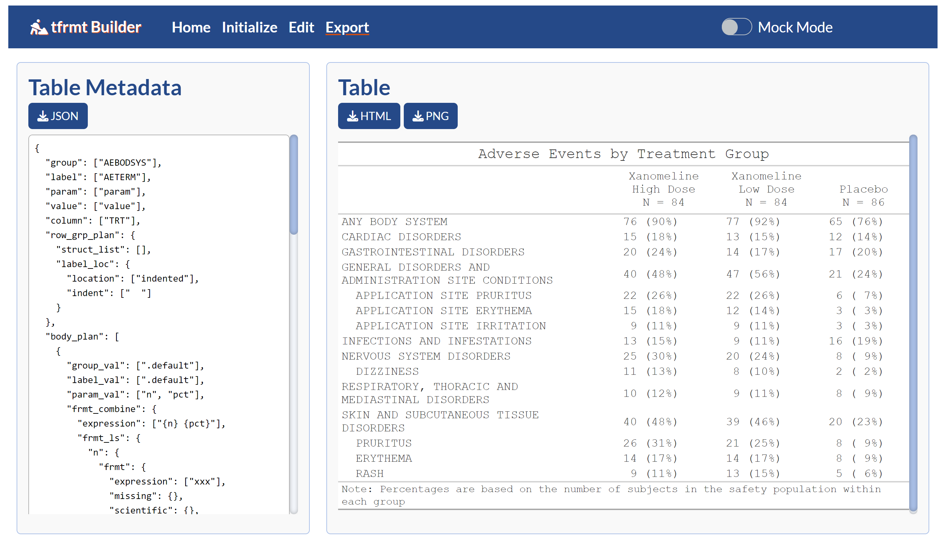


Slide 20
Build or modify table
Define starting point
Save
Result
JSON

Slide 21
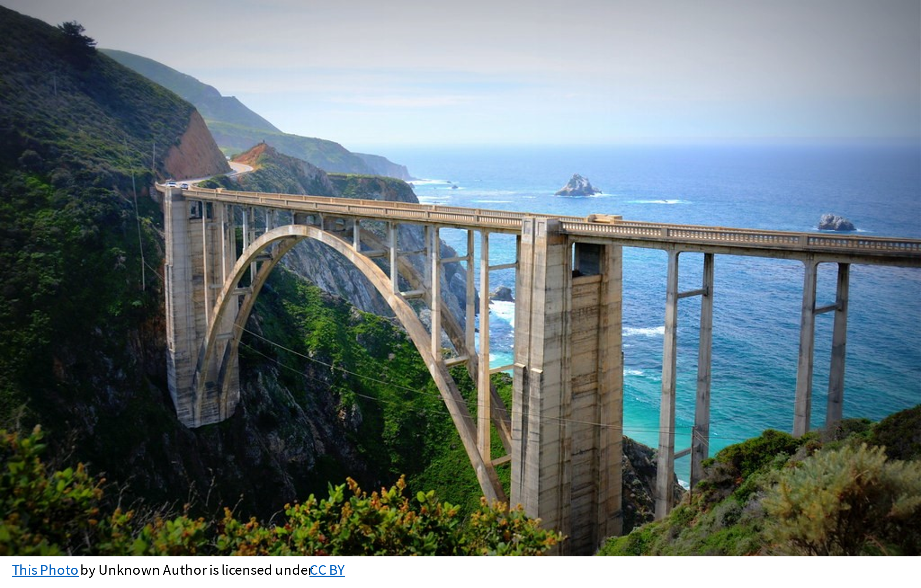
This Photo by Unknown Author is licensed under CC BY

Slide 22
Thank you!
gsk-biostatistics.github.io/tfrmt
gsk-biostatistics.github.io/tfrmtbuilder

